Slide 1
Chapter 5
GASES
Dr. Sultana Bedoura

Slide 2
Lecture Plan
Introduction
Pressure of a Gas
Boyle’s Law
Charle’s Law
Avogadro’s Law
Ideal Gas Equation
Density and molar mass calculation
Gas stoichiometry
Dalton’s Law
Kinetic molecular theory of Gases
Deviation from ideal behavior

Slide 3
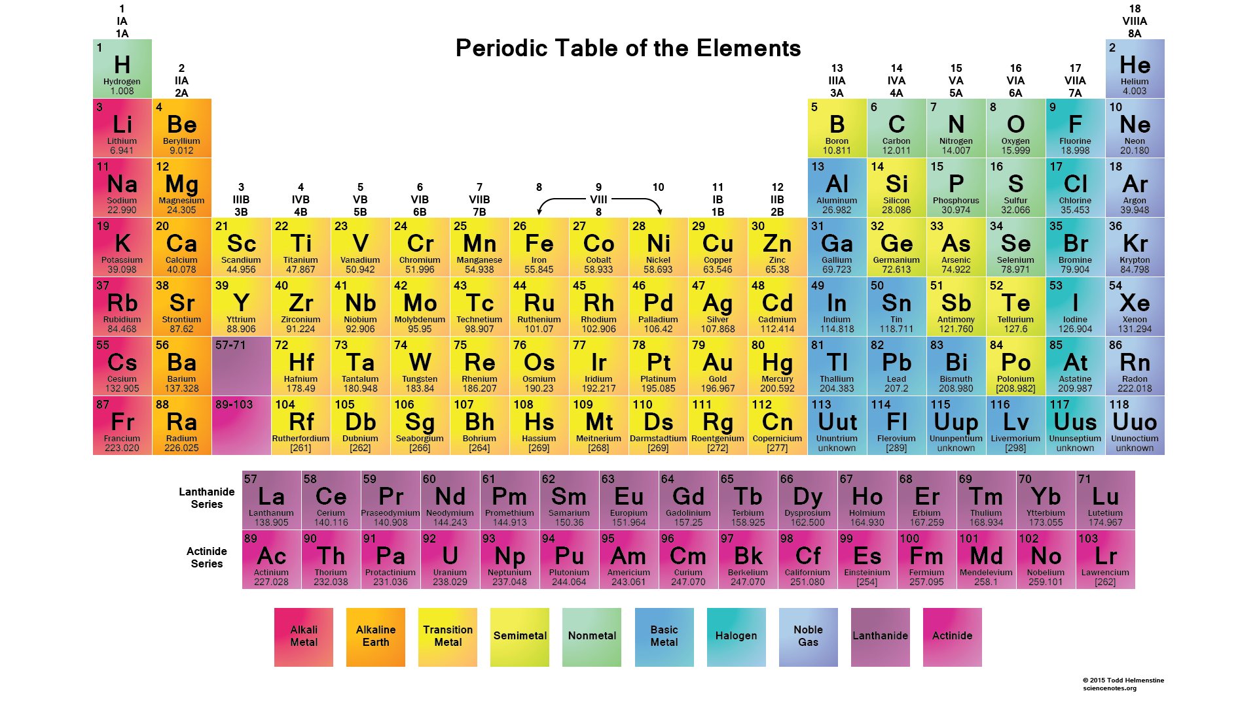
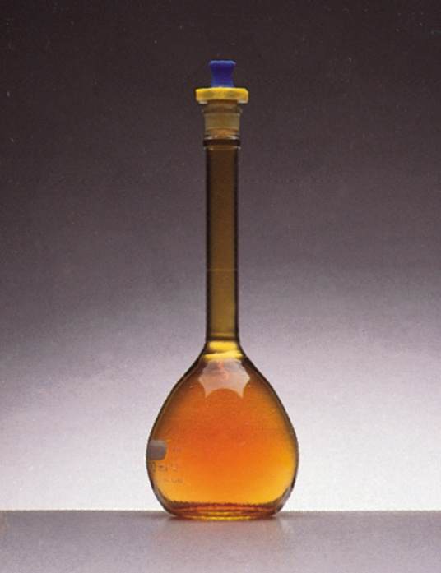
Introduction
Difference between Gas and Vapor:
Gas: a substance that is normally in the gaseous state at ordinary temperatures and pressures
Vapour: the gaseous form of any
substance that is a liquid or a solid at
normal temperatures and pressures
Physical characteristic of Gases:
Assume volume and shape of their containers
The most compressible state of matter
Evenly and completely mix if confined to the container
Lower densities than liquids and solids
Gases @ 1 atm and 25 ºC
Elements | Compounds
H₂ | HF
N₂ | HCl
O₂ | HBr
O₃ | CO
F₂ | CO₂
Cl₂ | NH₃
He | NO
Ne | NO₂
Ar | N₂O
Kr | SO₂
Xe | H₂S
Rn | HCN
NO₂ gas

Slide 4
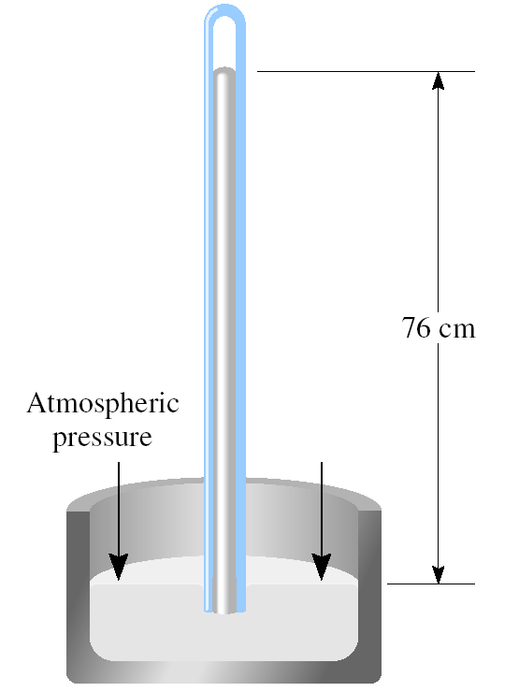
Pressure of a Gases
Atmospheric Pressure: Atmospheric pressure is the pressure exerted by the earth’s atmosphere
Standard atmospheric pressure (1 atm): pressure that supports a column of mercury exactly 760mm (or 76 cm) high at 0⁰C at sea level
Pressure :
Units of pressure:
76 cm
Force
Pressure =
Atmospheric
Pressure
Area
Where, force = mass x acceleration
1 pascal (Pa) = 1 N/m²
1 atm = 760 mmHg = 760 torr
1 atm = 101,325 Pa =101.325 kPa

Slide 5
Exercise
The atmospheric pressure in San Francisco on a certain day was 732 mmHg. What was the pressure in kPa?

Slide 6
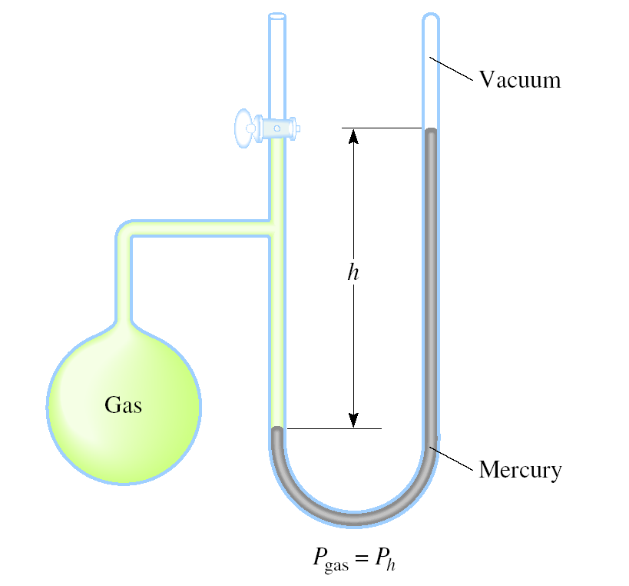
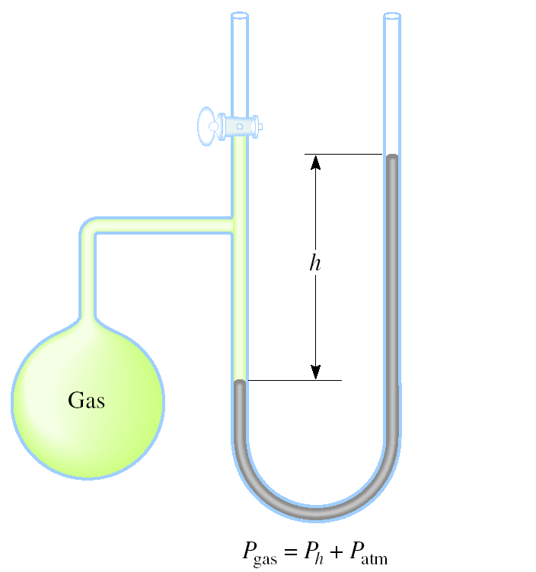
Manometers Used to Measure Gas Pressures
Measure gas pressure other than atmosphere
There are two types: closed tube and open tube for P_{gas}<P_{atm} and P_{gas}>P_{atm} respectively
Vacuum
h
h
Mercury
CLOSED-TUBE
OPEN-TUBE
P_{gas} = P_{h}
P_{gas} = P_{atm} +P_{h}

Slide 7
The Gas Laws
Boyle's Law
The Pressure- Volume relationship
Charles’ and Gay-Lussac’s Laws
Temperature-Volume relationship
Avogadro’s Law
Volume- Amount relationship

Slide 8
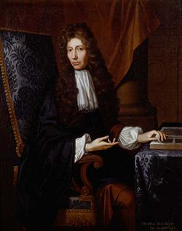
Pressure-Volume relationship: Boyle’s Law
Robert Boyle (1627 – 1691). British chemist and natural philosopher. Wrote the book
“The Skeptical Chymist (1661)” influenced generation of chemists.

Slide 9
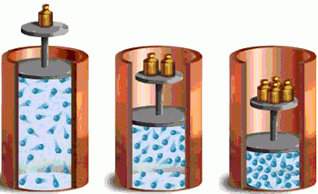
Boyle’s Law
The pressure of a fixed amount of gas at a constant temperature is inversely proportional to the volume of the gas.
[@ constant temperature & amount of gas]
where k ₁ is a constant called the
proportionality constant
1
P α
V
1
P = k₁ x
V
PV = k₁
P₁V₁ = P₂V₂
As P (h) increases V decreases

Slide 10
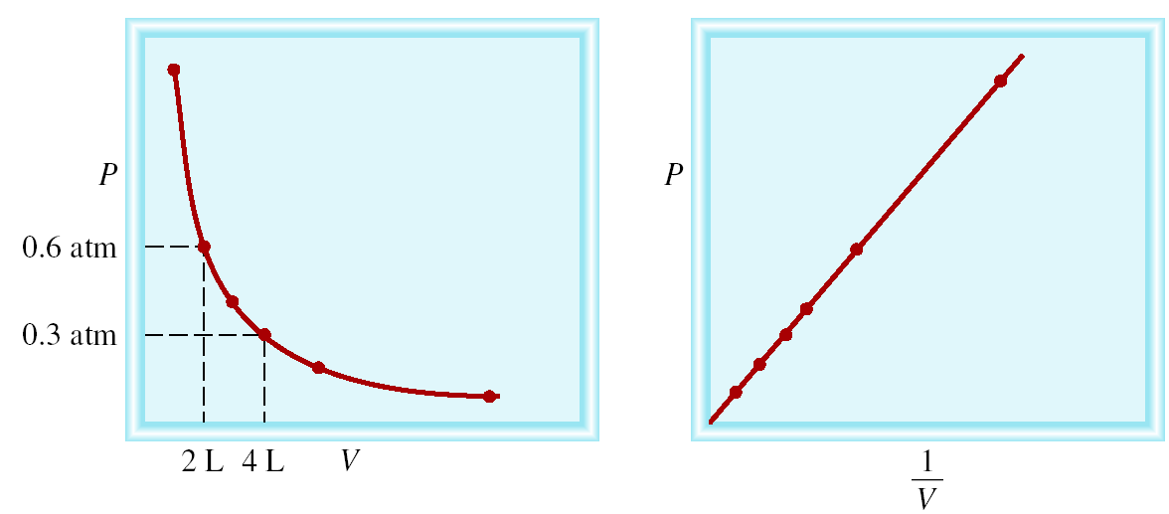
Boyle’s Law
p
p
0.6 atm
0.3 atm
2 L 4 L V
1
V
P α 1/V [@ constant temperature & amount of gas]
P x V = constant
P₁ x V₁ = P₂ x V₂

Slide 11
Exercise
A sample of chlorine gas occupies a volume of 946 mL at a pressure of 726 mmHg. What is the pressure of the gas (in mmHg) if the volume is reduced at constant temperature to 154 mL?
We know that, Given,
P x V = constant
P₁ = 726 mmHg
⇒ P₁ x V₁ = P₂ x V₂
V₁ = 946 mL
P₁ x V₁
⇒ P₂ =
V₂ = 154 mL
V₂
P₂ = ?
726 mmHg x 946 mL
=
154 mL
= 4460 mmHg

Slide 12
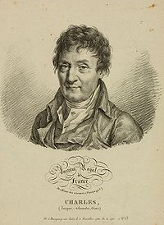
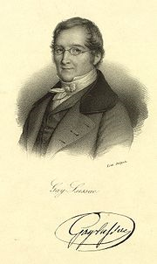
Temperature-Volume Relationship: Charles's-Gay-Lussac’s Law
Joseph Louis Gay-Lussac
French chemist and physicist. He was a balloon enthusiast. Once he ascended to an altitude of 20,000 ft to collect air samples for analysis.
Jacques Alexandre Cesar Charles French physicist. He was a gifted lecturer, an inventor of scientific apparatus and the first person to use hydrogen to inflate balloons.

Slide 13
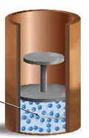
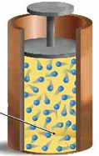
Temperature-Volume Relationship: Charles's-Gay-Lussac’s Law
The volume of a fixed amount of gas maintained at constant pressure is directly proportional to the absolute temperature of the gas.
V α T [ @ constant P and amount of gas]
V = constant x T
V₁ / T₁ = V₂ / T₂
Temperature must be in Kelvin
T (K) = t (⁰C) + 273.15
Low temperature High temperature
As T increases V increases

Slide 14
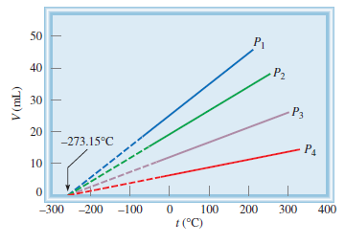
Variation of Gas Volume with Temperature
at Constant Pressure
Each line represents the variation
at a certain pressure
The pressures increase from P₁ to P₄
The solid portions of the lines
represent the temperature region
above the condensation point
The dashed lines intersect at the point
representing zero volume and a temperature of -273.15 ⁰C

Slide 15
Another form of Charles’s Law
For constant amount of gas and volume, the pressure is proportional to the temperature
P α T [when, constant V and amount of gas]
P = constant x T
P/T = constant
P₁/T₁ = P₂ /T₂
Temperature must be in Kelvin
T (K) = t (⁰C) + 273.15

Slide 16
Exercise
A sample of carbon monoxide gas occupies 3.20 L at 125 ⁰C. At what temperature will the gas occupy a volume of 1.54 L if the pressure remains constant?
We know, Given,
V₁ = 3.20 L
T₁ = 125 (⁰C) + 273.15 (K) = 398.15 K
V₂ = 1.54 L
V₁ / T₁ = V₂ /T₂
V₂ x T₁
T₁ = 125 ⁰C
T₂ =
V₁
T₂ = ?
1.54 L x 398.15 K
=
3.20 L
= 192 K

Slide 17
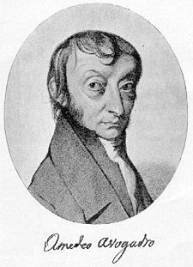
Volume-Amount Relationship: Avogadro’s Law
Amedeo Avogadro (1776 – 1856). Italian mathematical physicist. His most famous work, now known as Avogadro’s law, was largely ignored his lifetime.

Slide 18
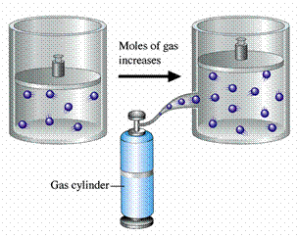
Volume-Amount Relationship: Avogadro’s Law
At constant pressure and temperature, the volume of a gas is directly proportional to the number of moles of the gas present
V α n [@ constant temperature & pressure]
V = constant x n
V / n = constant
V₁ / n₁ = V₂ / n₂

Slide 19
Exercise
Ammonia burns in oxygen to form nitric oxide (NO) and water vapor. How many volumes of NO are obtained from one volume of ammonia at the same temperature and pressure?
4NH₃ + 5O₂ 4NO + 6H₂O
1 mole NH₃ 1 mole NO
At constant T and P
1 volume NH₃ 1 volume NO

Slide 20
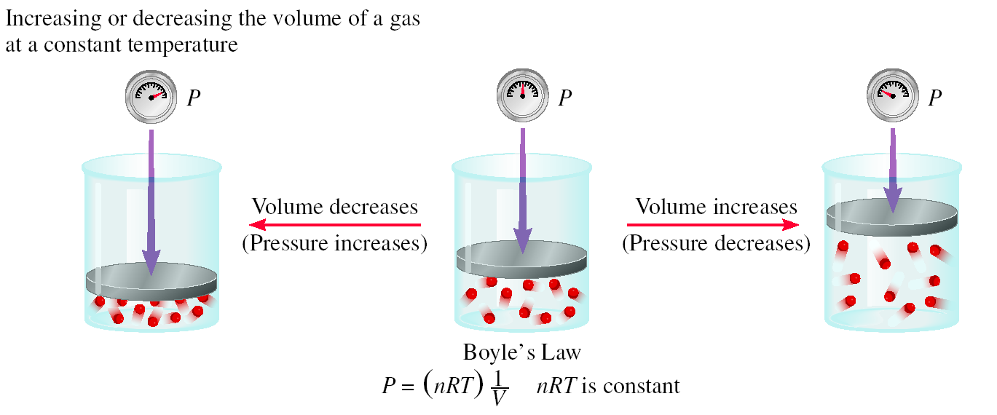
Schematic illustrations of Boyle’s law

Slide 21
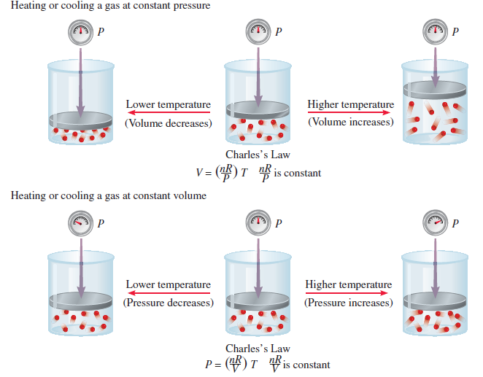
Schematic illustrations of Charles’s Law

Slide 22
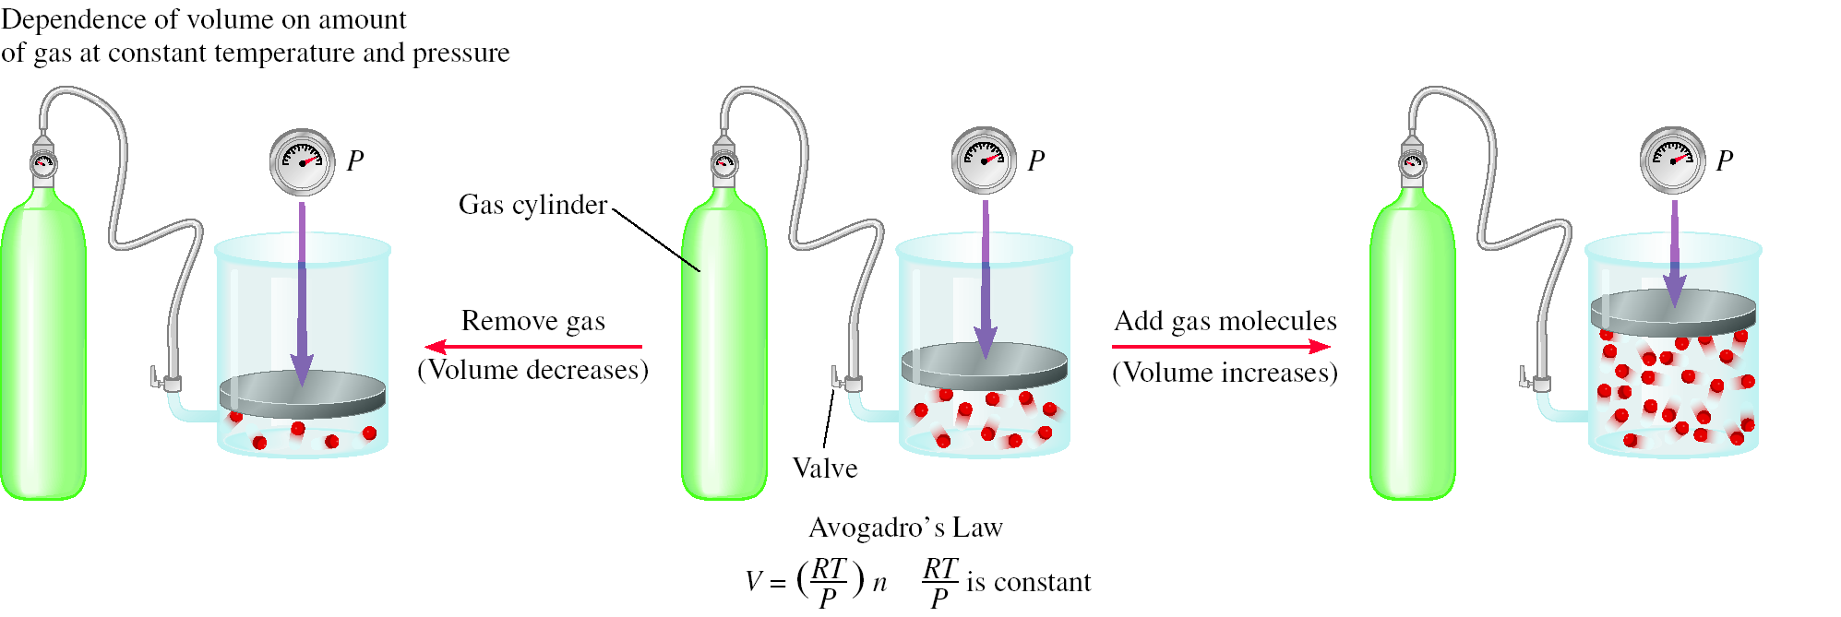
Schematic illustrations of Avogadro’s Law

Slide 23
Ideal Gas Equation
1
Boyle’s law : V α (at constant n and T)
Charles’ law : V α T (at constant n and P)
Avogadro’s law: V α n (at constant P and T)
P
nT
V α
P
nT
V = constant x
P
nT
V = R x
R is the gas constant
P
PV = nRT

Slide 24
Ideal Gas
Ideal gas: a hypothetical gas whose molecules do not attract or repel one another and their volume is negligible compared with the volume of the container
The ideal gas concept is useful because it obeys the ideal gas law and is amenable to analysis under statistical mechanics
At standard temperature and pressure, most real gases behave qualitatively like an ideal gas, many gases such as N₂, O₂, H₂, noble gases, and some heavier gases like CO₂ can be treated like ideal gases within reasonable tolerances
Generally, a gas behaves more like an ideal gas at higher temperature and lower pressure

Slide 25
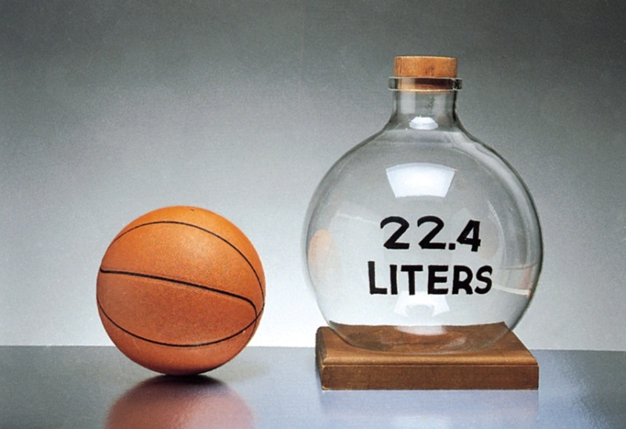
Standard Temperature and Pressure (STP)
The conditions 0⁰C (273.15 K) and 1 atm are called standard temperature and pressure (STP)
Experiments show that at STP, 1 mole of an ideal gas occupies 22.414 L
Unit of Gas constant at STP:
PV = nRT
PV
(1 atm)(22.414L)
R =
=
nT
(1 mol)(273.15 K)
R = 0.082057 L • atm / (mol • K)

Slide 26
Exercise
What is the volume (in liters) occupied by 49.8 g of HCl at STP?
PV = nRT
T = 0 ⁰C = 273.15 K
nRT
V =
P = 1 atm
P
1 mol HCl
L•atm
n = 49.8 g x
1.37 mol x 0.0821 x 273.15 K
36.45 g HCl
mol•K
V =
= 1.37 mol
1 atm
V = 30.7 L

Slide 27
Density (d) Calculations
PV = nRT
m
PM
………. (2)
⇒
=
V
RT
n
P
⇒
=
………. (1)
V
RT
If d is the density of the gas in g/L,
By definition,
If m is the mass of the gas in g &
M is the molar mass of the gas
Then,
m
d =
V
m
From equation 2 ⇒
n
=
M
From equation 1 ⇒
PM
d
=
RT
m
P
=
dRT
VM
RT
M =
P

Slide 28
Exercise
A 2.10-L vessel contains 4.65 g of a gas at 1.00 atm and 27.0 ⁰C. What is the molar mass of the gas?
4.65 g
g
dRT
m
M =
d =
=
= 2.21
P
V
2.10 L
L
g
L•atm
2.21
x 0.0821 x 300.15 K
L
mol•K
M =
1 atm
M = 54.5 g/mol

Slide 29
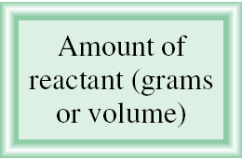
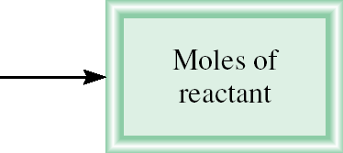
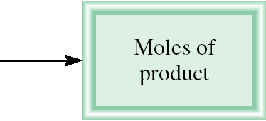
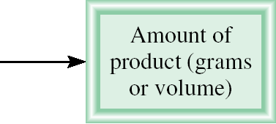
Gas Stoichiometry
What is the volume of CO₂ produced at 37ºC and 1.00 atm when 5.60 g of glucose are used up in the reaction:
C₆H₁₂O₆ (s) + 6O₂ (g) 6CO₂ (g) + 6H₂O (l)
g C₆H₁₂O₆ mol C₆H₁₂O₆ mol CO₂ V CO₂
1 mol C₆H₁₂O₆
6 mol CO₂
5.60 g C₆H₁₂O₆
x
x
= 0.187 mol CO₂
180 g C₆H₁₂O₆
1 mol C₆H₁₂O₆
L•atm
0.187 mol x 0.0821 x 310.15 K
nRT
mol•K
V =
=
= 4.76 L
P
1.00 atm

Slide 30
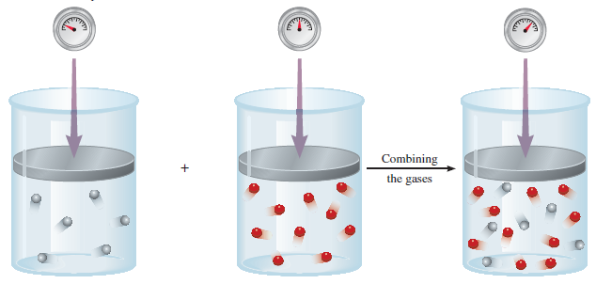
Dalton’s Law of Partial Pressures
V and T are constant
Total pressure of a mixture of gases is just the sum of the pressures that each gas would exert if it were present alone
P₁
P₂
P_{total} = P₁ + P₂

Slide 31
Dalton’s Law of Partial Pressures
Consider, A and B gases are in a container of volume V
Where, the total no of mole, n = n_{A} + n_{B}, and P_{A}, P_{B} are partial pressures of gases A and B
Total pressure of a mixture of a gas depends on the total number of moles of gas, not on the nature of the gas
n_{A}RT
P_{A} =
n_{A} is the number of moles of A
V
n_{B}RT
n_{B} is the number of moles of B
P_{B} =
V
n_{A}RT
n_{B}RT
RT
nRT
P_{T} = P_{A} + P_{B} = + = ( n_{A} + n_{B}) =
V
V
V
V

Slide 32
Partial Pressure
Total pressure of a mixture of gases,
P_{T} = P₁ + P₂+ P₃ + ……………………
where P₁, P₂, P₃, … are the partial pressure of the components 1, 2, 3, …
Relation among partial pressure, total pressure and mole fraction:
where X_{A} is mole fraction of A
P_{A}
n_{A}RT/V
n_{A}
=
=
n_{A} + n_{B}
= X_{A}
P_{T}
(n_{A} + n_{B}) RT/V

Slide 33
Mole fraction
The mole fraction is a dimensionless quantity that expresses the ratio of the number of moles of one component to the number of moles of all components present
The mole fraction of component i in a mixture, X_{i} =
The partial pressure of A and B, P_{A} = X_{A} P_{T} and P_{B} = X_{B} P_{T}
If a system contains more than two gases, P_{i} = X_{i} P_{T}
The sum of the mole fractions for a mixture of gases must be unity
X_{A} + X_{B} = 1
n_{i}
n_{T}
n_{A}
n_{B}
n_{A} + n_{B}
+
n_{A} + n_{B}
= 1

Slide 34
Exercise
A sample of natural gas contains 8.24 moles of CH₄, 0.421 moles of C₂H₆, and 0.116 moles of C₃H₈. If the total pressure of the gases is 1.37 atm, what is the partial pressure of propane (C₃H₈)?
We know,
P_{i} = X_{i} P_{T}
P_{propane} = X_{propane}P_{T}
= x 1.37
= 0.0181 atm
Given,
P_{T} = 1.37 atm
n_{T} = 8.24 + 0.421 + 0.116
= 8.777 moles
P_{propane} = ?
0.116 moles
8.777 moles

Slide 35
Kinetic Molecular Theory of Gases
A gas is composed of molecules that are separated from each other by distances far greater than their own dimensions. The molecules can be considered to be points; that is, they possess mass but have negligible volume.
Gas molecules are in constant motion in random directions, and they frequently collide with one another. Collisions among molecules are perfectly elastic.
Gas molecules exert neither attractive nor repulsive forces on one another.
The average kinetic energy of the molecules is proportional to the temperature of the gas in Kelvin's. Any two gases at the same temperature will have the same average kinetic energy

Slide 36
Kinetic Molecular Theory of Gases
The average kinetic energy :
where, m = mass of the molecule, u = speed and
u² = mean square speed, which is the average of the square of the speeds of all the molecules:
Assumption 4 enables us to write,
The absolute temperature of a gas is a measure of the random motion of the molecules.
KE = ½ mu²
u₁² +u₂² +……….+ u_{N}²
u² =
N
KE α T , ½ mu² α T , ½ mu² = C T

Slide 37
Kinetic Theory of Gas and Gas Laws
Compressibility of Gases
Boyle’s Law
P α collision rate with wall
Collision rate α number density (no. of objects/unit volume)
Number density α 1/V
P α 1/V
Charles’ Law
P α collision rate with wall
Collision rate α average kinetic energy of gas molecules
Average kinetic energy α T
P α T

Slide 38
Kinetic Theory of Gas and Gas Laws
Avogadro’s Law
P α density and mass of a gas,
P α (n/V)T , [m α n]
For two gases, P₁ α (n₁/V₁)T₁ = C (n₁/V₁)T₁ P₂ α (n₂/V₂)T₂ = C (n₂/V₂)T₂
where C = constant, when P₁ = P₂, T₁ = T₂, and V₁ = V_{2 ,} n₁ = n₂
Dalton’s Law of Partial Pressures
Molecules do not attract or repel one another
P exerted by one type of molecule is unaffected by the presence of another gas
P_{total} = ΣP_{i}

Slide 39
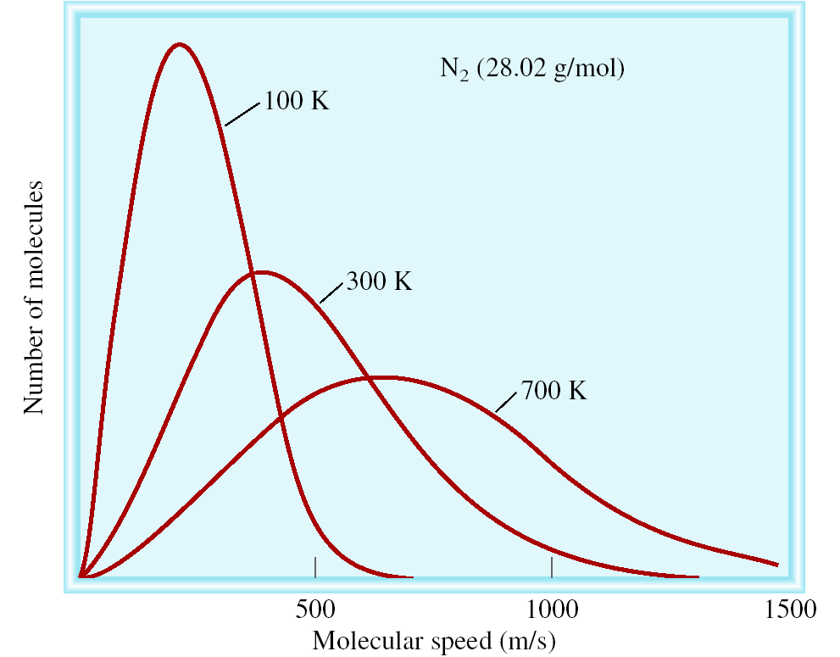
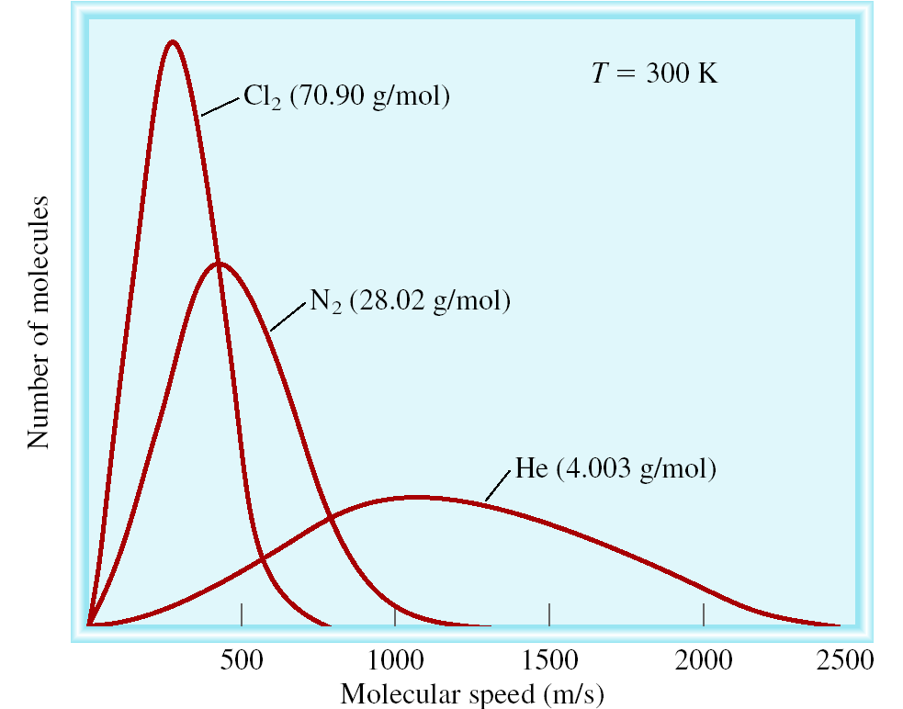
Distribution of speeds
The distribution of speeds for N₂ gas molecules at three different temperatures
The distribution of speeds of three different gases at the same temperature

Slide 40
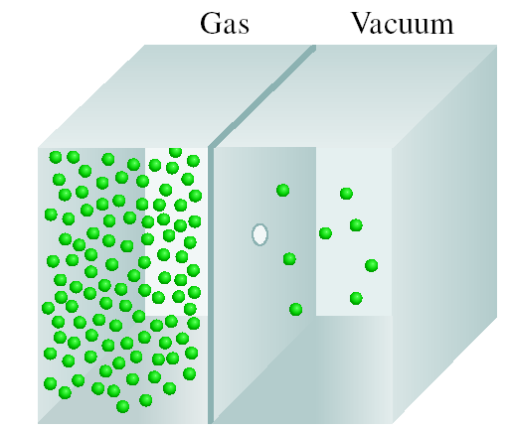

Diffusion & Effusion
Gas diffusion is the gradual mixing of molecules of one gas with molecules of another by virtue of their kinetic properties.
Gas effusion is the process by which gas under pressure escapes from one compartment of a container to another by passing through a small opening.
r₁
t₂
√
M₂
r₂
=
t₁
=
M₁
Molecular path

Slide 41
Exercise
Nickel forms a gaseous compound of the formula Ni(CO)_{x}. What is the value of x given that under the same conditions methane (CH₄) effuses 3.3 times faster than the compound?
r₁
t₂
√
M₂
=
=
r₁ = 3.3 x r₂
r₂
t₁
M₁
M₁ = 16 g/mol
2
(
r₁
)
M₂ =
x M₁
r₂
x = ?
= (3.3)² x 16 = 174.2
58.7 + x • 28 = 174.2
x = 4.1 ~ 4

Slide 42
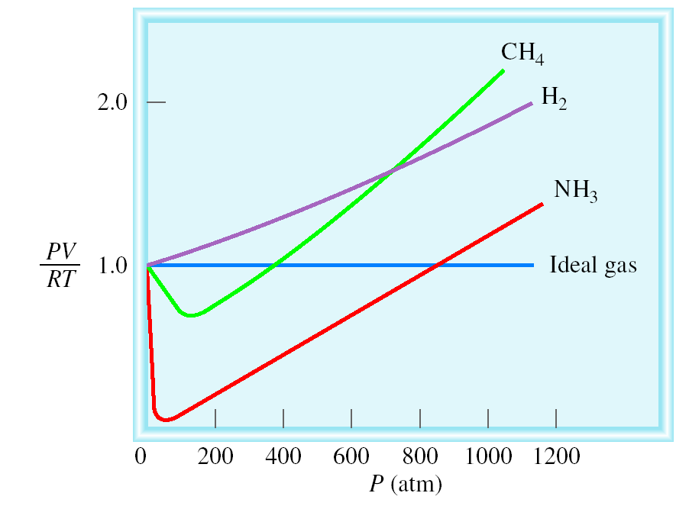
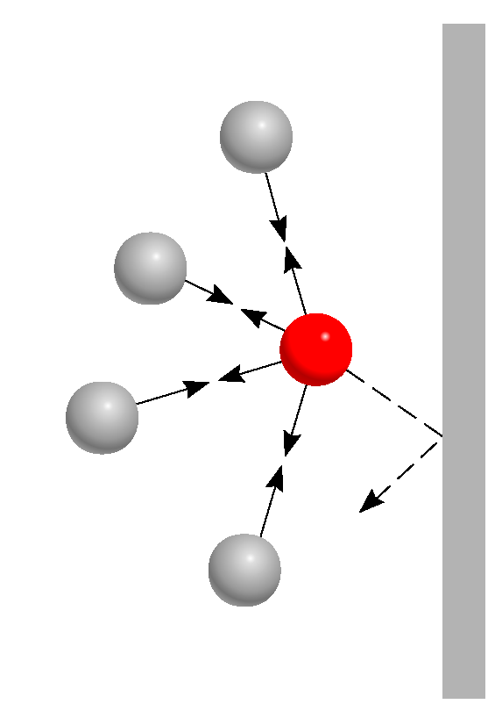
Deviations from Ideal Behavior
Ideal Gas satisfies two distinct behaviors:
No attractive /repulsive force to
one another.
Volume is negligible compared to
the container
Repulsive Forces
Attractive Forces
Effect of intermolecular forces on the pressure exerted by a gas
Ideal gas equation
PV = nRT
For 1 mole of ideal gas
PV
n =
= 1.0
RT

Slide 43
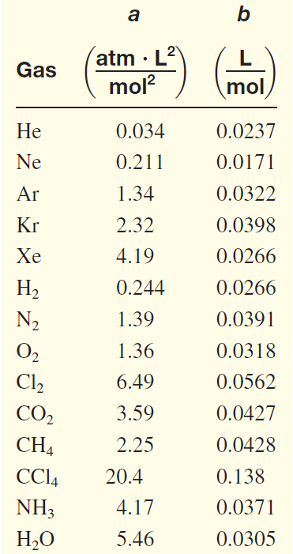
Van der Waals equation Non-ideal gas
Pressure correction:
Concern intermolecular interactions
Volume correction:
Concern volume occupied by gas
V_{ideal} = V_{real} - nb
Van der Waals Equation:
van der Waals constants
of some common gases
an²
P_{ideal} = P_{real} +
V²
(
an²
)
P + (V – nb) = nRT
V²

Slide 44
Thank You

